Slide 1
Single Minute Exchange of Dies (SMED)
Notes:
DO: Welcome everyone to the class. Introduce yourself and the notion of SMED.

Slide 2

Other Modules In This Series:
5S
Standard Work
Total Productive Maintenance (TPM)
Administrative Lean
Cell Design/ Production Preparation Process (3P)
Kaizen
Kanban
Problem Solving
Poka Yoke Quality Systems
Transaction Process Improvement (TPI)
Cause & Effect Diagram with the Additions of Cards (CEDAC)
Single Minute Exchange of Dies (SMED)
Value Stream Mapping (VSMi®)
Visual Management
Managing Daily Process Excellence
For More Information Please Contact:
Mark DeLuzio, President and CEO
+1.860.234.0915
mark.deluzio@leanhorizons.com
Strategically Creating Value Through the Elimination of Waste

Slide 3
This document contains confidential
and proprietary information owned
by Lean Horizons Consulting, LLC.
Any disclosure, use, copying or
distribution of this information without the express written consent of Lean Horizons Consulting is strictly prohibited.

Slide 4
Ground Rules for Event
Safety first (use personal protective equipment)
Active participation by all
Start and end on time
All electronic gadgets (phones, pagers, etc) turned to “off” or “silent”
Computers to be used only when instructed
Keep an open mind to change
Don’t let “perfect” get in the way of “better”
Notes:
DO: Perform Group Introductions. Pick an ice-breaker or exercise to warm the team up to the event. (Icebreaker Example: Everyone uses their name tent and writes a “Personal License Plate” in which they have 2 minutes to creatively use a total of 7 letters or numbers to tell us something about themselves. Examples “LV2SAIL” OR “DADOV5”
DO: Review Event Ground Rules.
ASK: “Does anyone have any rules they would like to see added?”
ASK: “Does everyone agree to these?”

Slide 5
Goal of SMED Module
To define SMED and apply the SMED process to achieve a target goal for your business.
SMED
Definition
SMED
Process
SMED
Review
Notes:
DO: Introduce the notion of SMED and the goal of this event.

Slide 6
SMED
SMED
Definition
SMED
Process
SMED
Review
Objectives:
Define SMED
Identify purpose and benefits of SMED
Review examples of SMED success
Define set-up time
Identify the steps of the SMED methodology
Notes:
DO: Review chapter objectives.

Slide 7

SMED Definition
SMED Definition
Definition
Single Minute Change of Dies or decreased set-up time
Set-up time should be less than takt time
Purpose of SMED
Reduces the need for inventory
Provides more capacity and flexibility
Enables serving the customer better!
Shigeo Shingo believed that any set-up time could be reduced by 59/60ths
Notes:
DO: Ask the class to define TAKT time. (answer: takt is the rate at which the customer demands the product or service). How is it different from set-up time?
DO: Ask the class if there are other advantages to decreased set-up time? (sample answers include: increased capacity, reduced inventory, reduced lead time, ability to change models more frequently, shorter runs limit quality exposure, improved responsiveness and customer delivery, reduced material waste due to less adjustment at changeover).
SAY: “Here is a target set by Shigeo Shingo. What does this mean to you? To achieve this level of performance, multiple reviews and a focus on the elimination of waste associated with the changeover. There also needs to be focus on design for quick changeover (SMED) as well as good standard work.”

Slide 8
Benefits
SMED Definition
Less adjustments means less chance for errors
Elimination of trial processing reduces material waste
Advanced preparation of operating conditions helps stabilize
product quality
Increases scheduling flexibility/capacity
Reduces the need for on-hand inventory
Large scale defect problems in inventory are less likely
Improved service levels for customers
Notes:
DO: Review benefits of SMED.
DO: Ask the class if they can think of other benefits that should be added to this list (write them down).
SAY: “There are many benefits to SMED. SMED is a strong complement to many other lean tools.”

Slide 9
SMED Improvements
SMED Definition
Companies Descriptions
1
Wiremold Company
Reduced changeover time from 2 hours to 10 minutes
2
Hitachi Automotive
Products
Reduced changeover from 1.5 hours to 20 minutes
3
Steelmill
Three 500 ton presses changed over from 3 ½ hours to 30 minutes
4
Automotive OEM
Injection molders: all molds and inserts changed from
1 ½ hours to 9 minutes
5
Machine Shop
Screw machine tooling changed and new set-up, reduced from 1 hour to 8 minutes
Notes:
DO: Describe the case studies – how SMED has improved other companies.
DO: Ask the class if anyone experienced SMED improvements in their current or former roles within their organization.
SAY: “The SMED improvements are tangible and occur in a variety of industries and with a variety of processes. Expect to see similar results when SMED is properly implemented in your facility.”

Slide 10
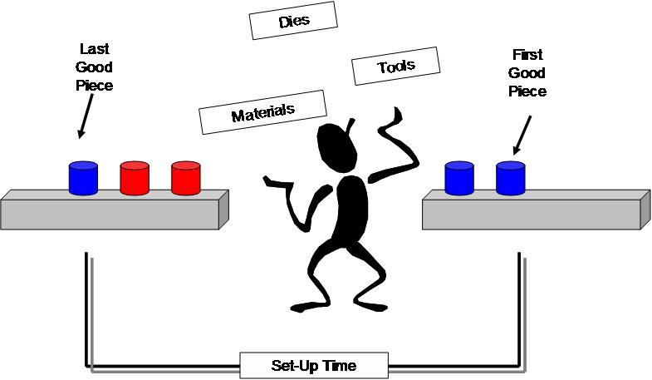
Set-Up Time
SMED Definition
Notes:
SAY: “Setup time… how is it measured? It is the time from the last good part run before the changeover to the first good piece of the new setup. This incorporates any time required for process adjustments and scrap pieces associated with the changeover.”
SAY: “Let’s apply this concept to our everyday environment.”
ASK: “What would be considered the set-up time for:
A restaurant table changeover? (answer: the time it takes from when the last party left to when the next party is sitting down)
A doctor’s office visit changeover? (answer: the time it takes from when the last patient left the room to when the next patient has entered the room)
A dishwasher changeover? (answer: the time it takes from when the dishwashing machine stops to when the dishwasher is loaded and ready to be started)
A garbage can changeover? (answer: the time it takes from when the last item of trash is thrown into the bag to when the next empty bag is placed within the can.)”
DO: Ask group if they can think of any other examples.

Slide 11
SMED Methodology
SMED Definition
    1. Observe and document the current set-up
2. Separate internal and external elements
3. Improve each element
4. Observe and document the new set-up process
5. Standardize the new set-up process
6. Celebrate your success
Notes:
DO: Review the steps of the SMED Methodology. Explain that you will go into much further detail about each of these steps.

Slide 12
Exercise: SMED Charter Review
SMED Definition
Objective
Review the SMED Charter for the event against charter criteria
Instructions
Time to Complete
As a team review the event charter and answer the following questions:
What is the business need for this event?
What are the clear geographic boundaries?
Who is the owner?
What are the goals for this event?
30 minutes
Deliverable
Make any modifications
to charter as necessary.
Notes:
DO: Review the charter for this event.

Slide 13
SMED
SMED
Definition
SMED
Process
SMED
Review
Objectives:
Review the SMED Methodology
Observe the current set-up process and complete Pareto Analysis
Separate internal elements from external elements
Develop and implement an improvement plan
Document the new set-up
Notes:
DO: Review chapter objectives.

Slide 14
SMED Methodology
SMED Process
    1. Observe and document the current set-up
2. Separate internal and external elements
3. Improve each element
4. Observe and document the new set-up process
5. Standardize the new set-up process
6. Celebrate your success
Notes:
SAY: “There is a specific methodology to execute a SMED.” (review steps on the slide)
SAY: “Now we will review each one of the steps in this process in more detail.”

Slide 15
SMED Methodology
SMED Process
    1. Observe and document the current set-up
2. Separate internal and external elements
3. Improve each element
4. Observe and document the new set-up process
5. Standardize the new set-up process
6. Celebrate your success

Slide 16
Observe and Document the Current Set-Up
SMED Process
Searching | Looking for tools, jigs, fixtures, etc.
Fixture Change | Replacing one fixture with another
Tool Change | Replacing existing tooling
Programming | Making adjustments or changes to a CNC program in order to accommodate the new set-up
Walk time | The time an operator must walk to retrieve a fixture, tools, etc
1st Piece | The time required to produce a good unit after the initial set-up
Gage | The time required to qualify the 1st piece
Videotaping the current set-up process for analysis is a best practice
Notes:
SAY: “This list provides you with some things to look for during the “Observe and Document” step in a SMED event.”
DO: Walk through each step for current state observations
NOTE: A video recorder should have been used and the video observed for this event. It is an extremely important tool for the analysis.

Slide 17
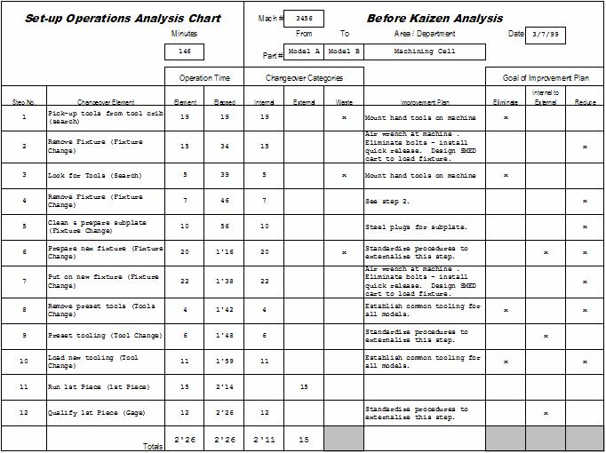
Observe and Document the Current Set-Up
SMED Process
Notes:
SAY: “We mentioned to observe and document the current set-up process. This form shows how to complete the set-up analysis chart.”
DO: Review the form that is used when observing the current process and how it is used.

Slide 18
Set-Up Pareto Analysis
SMED Process
Notes:
SAY: “Compile the various elements of the set-up process in a pareto chart to identify the drivers of the set-up. A common use of the pareto chart is to identify drivers for an activity. The same principle applies and that is to focus on the items that drive the set-up time. In this example, those elements are Fixture Change, Search and Tool Change.”

Slide 19
SMED Methodology
SMED Process
    1. Observe and document the current set-up
2. Separate internal and external elements
3. Improve each element
4. Observe and document the new set-up process
5. Standardize the new set-up process
6. Celebrate your success

Slide 20
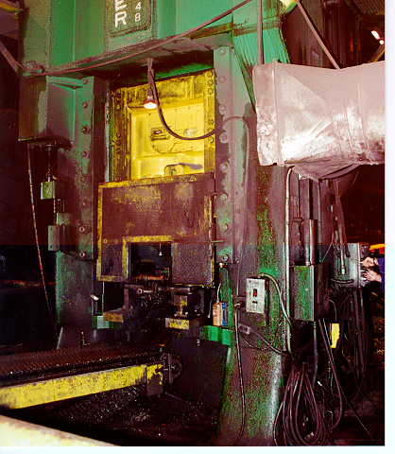
Types of Set-Up Time
SMED Process
Internal
Those activities that must be performed while the machine is shut down
Example: Removing dies and tooling
External
Those activities that are performed while the machine is operating
Example: Preparing tooling for next set-up
Both types of actions must be separated. Once the machine is stopped,
the worker should never depart to perform any part of the external set-up.
Notes:
DO: Describe internal vs. external set-up:
Internal – Items that must occur while the tool/mold/process is shut down
External – Changeover related items that can be done while the tool/mold/process is running.
SAY: “The next step of the process is to separate the internal activities from the external activities. These actions must be separated to achieve the expected results of the SMED. An important note here is to ensure the operator never leaves the machine once the machine is stopped.”
DO: Take a common example and ask the group what some internal set-up activities would be versus external.

Slide 21
Internal or External?
SMED Process
Set-up Operations Analysis Chart
Before Kaizen Analysis
Mach #
3456
Minutes
From
To
Area / Department
Date
3/7/23
146
Part #
Model A
Model B
Machining Cell
Operation Time
Changeover Categories
Goal of Improvement Plan
Step No.
Changeover Element
Element
Elapsed
Internal
External
Waste
Improvement Plan
Eliminate
Internal to
Pick-up tools from tool crib
x
x
External
Reduce
1
(search)
19
19
19
Mount hand tools on machine
2
Remove Fixture (Fixture
15
34
15
Air wrench at machine . Eliminate bolts -
x
Change)
install quick release. Design SMED cart
3
Look for Tools (Search)
5
39
5
x
to load fixture.
x
Mount hand tools on machine
4
Remove Fixture (Fixture
7
46
7
See step 2.
x
Change)
x
5
Clean & prepare subplate
10
56
10
Steel plugs for subplate.
(Fixture Change)
x
x
x
6
Prepare nex fixture (Fixture
20
1'16
20
Standardize procedures to externalize
Change)
this step.
7
Put on new fixture (Fixture
22
1'38
22
Air wrench at machine . Eliminate bolts -
x
Change)
install quick release. Design SMED cart
8
Remove preset tools (Tools
4
1'42
4
to load fixture.
x
x
Change)
Establish common tooling for all models.
9
Preset tooling (Tool Change)
6
1'48
6
Standardize procedures to externalize
x
this step.
x
x
10
Load new tooling (Tool Change)
11
1'59
11
Establish common tooling for all models.
11
Run 1st Piece (1st Piece)
15
2'14
15
12
Qualify 1st Piece (Gage)
12
2'26
12
Standardize procedures to externalize
x
this step.
Totals
2'26
2'26
2'11
15
Notes:
SAY: “We mentioned separating the internal from external activities. Properly post the internal and external activities on the Set-up Operations Analysis Chart.”

Slide 22
SMED Methodology
SMED Process
    1. Observe and document the current set-up
2. Separate internal and external elements
3. Improve each element
4. Observe and document the new set-up process
5. Standardize the new set-up process
6. Celebrate your success

Slide 23
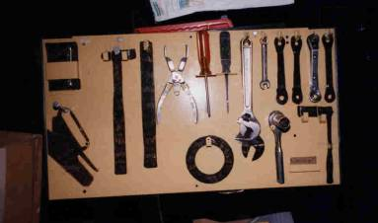
Develop Improvement Plan
SMED Process
5S is the key to a quick changeover
Every minute spent looking for tools, dies, jigs, or other materials adds to the set-up time
A strong 5S foundation will ensure that all required materials are in place when needed, clean, and in working condition
Notes:
ASK: “Who can define 5S and its purpose.”
NOTE: 5S review on next slide.

Slide 24
5S Review
SMED Process
5S Descriptions
1S
Sort
Define what is necessary and unnecessary
2S
Straighten
A place for everything and everything in its place
3S
Scrub
Identify the sources of uncleanliness
4S
Stabilize
Execute process to maintain/improve the standards of the first 3 S’s
5S
Sustain
A sustained, disciplined 5S culture in the workplace
Notes:
DO: Any improvement in set-ups starts with 5S. The 5Ss are Sort, Straighten, Scrub, Standardize, and Sustain. Any time spent looking for tools, gages, and other materials adds directly to set-up time. A strong 5S foundation will have a positive and direct impact on set-up reduction. Another benefit of good 5S is the improved Health and Safety of the set-up area.

Slide 25
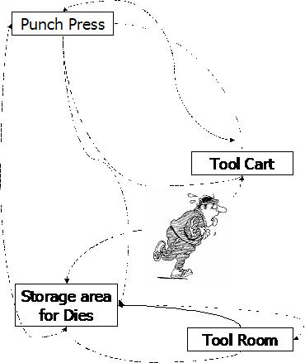
Develop Improvement Plan
SMED Process
Remember the 8 Wastes:
Defects
Over Production
Waiting
Non-Utilized Talent
Transportation
Inventory
Motion
Extra Processing
Notes:
DO: Ask the class how each of the 8 wastes can impact SMED.
Examples of each waste may include:
Overproduction: Extra parts produced to accommodate long changeover time.
Waiting: Die not available, need to wait for parts to pass gage test, a person to assist the operator to complete a task.
Transportation: Moving dies, moving produced parts from the machine, storing dies, walking to retrieve materials.
Processing: Adjusting the machine to produce a good part, adjusting die heights.
Inventories: Extra production to buffer during the changeover
Motion: Tightening bolts, finding gages, finding tools
Defects: Scrapping set-up parts, scrapping ‘adjustment’ parts, running the process before parts are cleared by QC (waste if the parts are truly scrapped)
Unused Creativity: Not engaging the operators, not engaging engineering, not including engineers and operators in the SMED event

Slide 26
Develop Improvement Plan
SMED Process
Convert as much of the internal set-up to the external set-up
Eliminate or reduce the internal and external set-up
Eliminate the adjustment process
Goal is to eliminate set-up altogether!
Once as much of the internal set-up has been converted to external set-up and waste has been eliminated:
  standardize the external set-up actions
  utilize quick fasteners
  use supplementary tools
Notes:
SAY: “There are many ways to achieve and sustain the improvement plan. Some ideas to consider include standardizing the external set-up actions, utilize quick fasteners instead of bolts and use supplemental tools to facilitate the set-up process.”

Slide 27
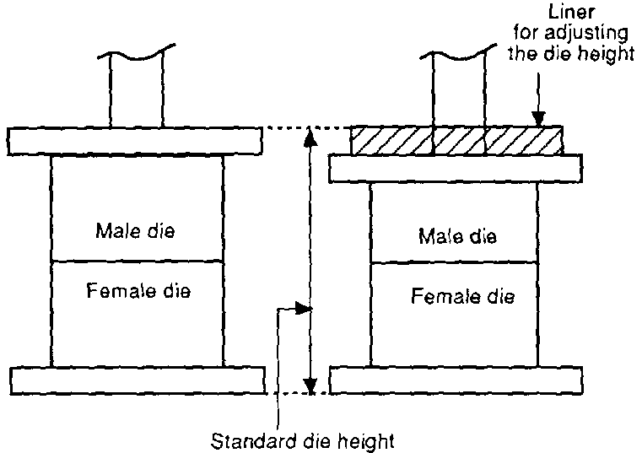
External Set-Up Actions
SMED Process
External Set-Up Actions
The die heights of a punch press or molding machine can be standardized by using the liner (spacer) so that stroke adjustment will be unnecessary
Source: Toyota Production System – Yasuniro Monden
Notes:
SAY: “We discussed the eight wastes and mentioned the waste of motion to adjust die heights. Here is an example of standardizing the die height on a press.”

Slide 28
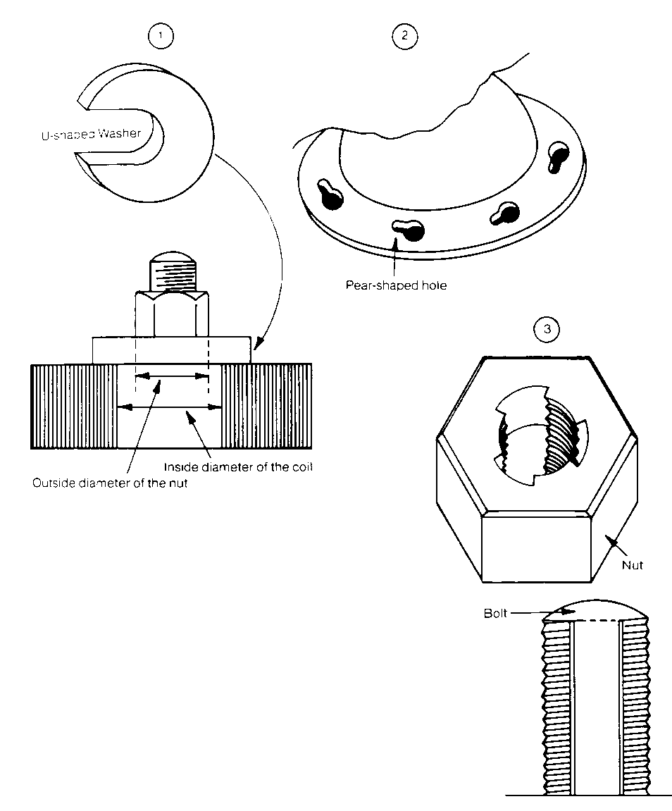
Using Quick Fasteners
SMED Process
Using Quick Fasteners
Usually a bolt is the most popular fastening tool
Because a bolt fastens at the final turning of the nut can loosen at the first turn, a convenient fastening tool that would allow only a single turning of the nut should be devised
Source: Toyota Production System – Yasuniro Monden
Notes:
SAY: “The waste associated with tightening bolts can be eliminated by using quick fasteners. Here is an example of their use.”

Slide 29
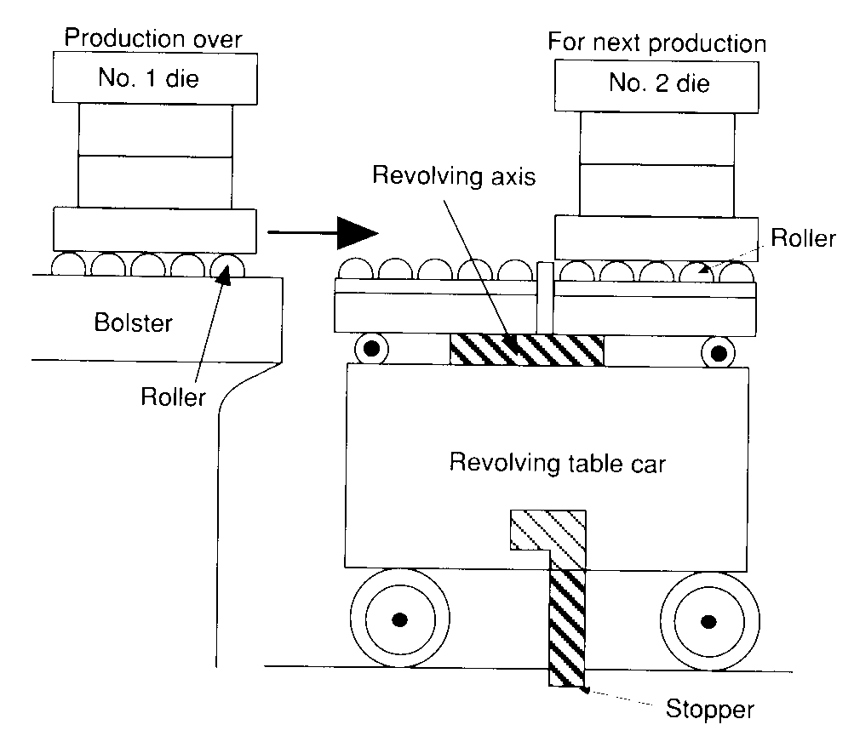
Using Supplementary Tools
SMED Process
Using Supplementary Tools
It takes a lot of time to attach a die or a bite directly to the punch press or the chuck of a lathe
Attach the die or bites to the supplementary tool in the external set-up phase, and then in the internal setup phase this tool can be set in the machine at one touch.
For this method, the supplementary tools must be standardized.
Example: The revolving table car
Source: Toyota Production System – Yasuniro Monden
Notes:
SAY: “To facilitate the exchange of dies, think of accessory tools to simplify the exchange. Note the safety precaution by installing a mechanism to ensure the stop does not move during the die exchange.”

Slide 30
Develop Improvement Plan
SMED Process
What must be done while the machine is shut down?
What can be done while the machine is running?
Challenge every element in the set-up!!
Establish a sound 5S foundation
Notes:
SAY: “Continue to challenge the traditional thinking as the improvement plan is developed. Among the questions to ask during the event are: (read points on slide)”

Slide 31
Improvement Checklist
SMED Process
Station tools, jigs, dies, etc. near the machine
Assure that all jigs, gauges, dies, tools, etc. function before the
set-up begins
Perform as many External elements as possible prior to the set-up
Two people working together may reduce net set-up time
Use functional clamps: One turn/One motion
Use visual control to eliminate adjustments
Notes:
SAY: “In preparation to implement the improvement plan, follow the items on this checklist to build a strong SMED process after the event. This list is not exhaustive, but by addressing these questions, the major areas of improvement can be addressed.”
ASK: “Are there any others you can think of?”

Slide 32
SMED Methodology
SMED Process
    1. Observe and document the current set-up
2. Separate internal and external elements
3. Improve each element
4. Observe and document the new set-up process
5. Standardize the new set-up process
6. Celebrate your success

Slide 33
Document the New set-up
SMED Process
List each element on the Set-up Operations Standard Chart
(after Kaizen)
Video tape the new set-up procedure.
Record the set-up time for each element
Note areas for future improvement
Notes:
SAY: “Now, document the new set-up developed from the analysis of the current set-up. There will still be opportunities to improve the set-up after the new set-up becomes the standard. To aid in training, videotape the new set-up procedure. Also, record the set-up time for the new set-up procedure and plan to continue monitoring the set-up time ongoing. The recommendation is to chart the set-up time and frequency and assess the trend. In the mode of continuous improvement, continue to look for future areas of improvement to take the process to the next level.”

Slide 34
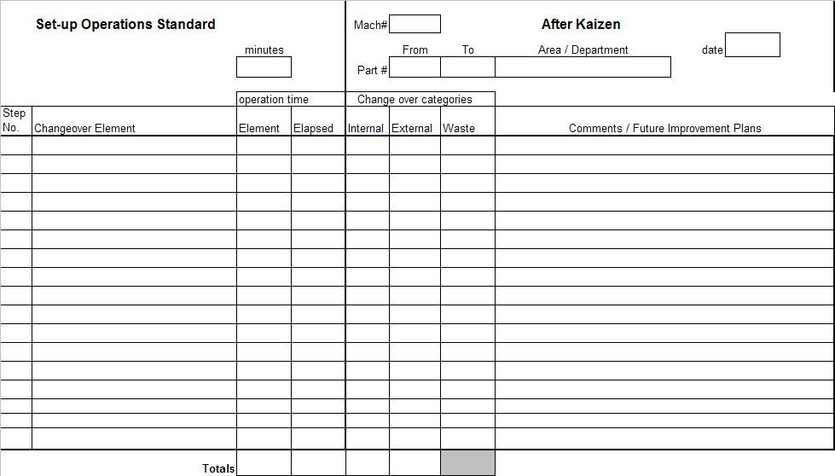
Document the New set-up
SMED Process
Notes:
DO: Explain form and its purpose.

Slide 35
SMED Methodology
SMED Process
    1. Observe and document the current set-up
2. Separate internal and external elements
3. Improve each element
4. Observe and document the new set-up process
5. Standardize the new set-up process
6. Celebrate your success

Slide 36
Standardize the New Procedure
SMED Process
The Set-Up Operations Standard chart will become the basis for the new set-up procedure
Prepare the appropriate detail and work instructions that will not be included on the Set-Up Operations Standard chart
Assure that all appropriate personnel are trained in the new procedure
Notes:
SAY: “As with the other lean tools, the new set-up procedure needs to be treated as standard work. Document the new set-up process on the same form used to document the current set-up earlier in the event.”
DO: Ask the class why standardization is important? What could happen?

Slide 37
SMED Methodology
SMED Process
    1. Observe and document the current set-up
2. Separate internal and external elements
3. Improve each element
4. Observe and document the new set-up process
5. Standardize the new set-up process
6. Celebrate your success
Notes:
SAY: “And finally, don’t forget to celebrate your success!”

Slide 38
SMED
SMED
Definition
SMED
Process
SMED
Review
Objectives:
Review the SMED Rules
Conduct review of key learnings
Organize team to begin SMED kaizen
Review necessary information for event report-out
Notes:
DO: Review chapter objectives.

Slide 39
SMED Guidelines
SMED Review
SMED begins and ends with the 5S’s
Change the Internal set-up into External, then improve the remaining Internal set-up time
Bolts are our enemies
If you have to use your hands make sure your feet stay put
Don’t rely on special fine-tuning skills
Standards are standard: they are NOT flexible
Standardize all SMED Operations
Notes:
SAY: “Here is a list of the SMED guidelines. Follow these with rigor and discipline and the opportunity for a successful SMED event and continued set-up time reduction.”

Slide 40
Review Exercise
SMED Review
2 Minute Review
In pairs, or in small groups, spend 5 minutes discussing key learnings and take-aways from this SMED Event thus far
One person from each group will share one learning that was discussed with the rest of the class
Notes:
DO: Lead the 2 Minute Review Exercise. Look to see that the group has gotten the key take-aways from the training.

Slide 41
Your Turn….Kaizen!
SMED Review
The following pages review the process for your team to apply SMED in order to kaizen the process.
Notes:
NOTE: At this point in the training, it is time to move into kaizen mode.

Slide 42
SMED Methodology
SMED Definition
    1. Observe and document the current set-up
2. Separate internal and external elements
3. Improve each element
4. Observe and document the new set-up process
5. Standardize the new set-up process
6. Celebrate your success
Notes:
DO: Review the steps they will follow for their SMED Event a final time.

Slide 43
Prepare for Final Report-Out to Management
SMED Review
All team members should contribute to the final report-out presentation to management
Report-out should include
  Introduction of Team
  Review of Event Charter
  Review of Current Set-Up
  Review of Internal and External Elements
  Review of Improved Process
  Review of new standardized procedures
Typical Report-Out times are 15 minutes for presentation and 15 minutes for questions
Notes:
DO: Cover report-out guidelines.

Slide 44
Other Modules In This Series:
5S
Standard Work
Total Productive Maintenance (TPM)
Administrative Lean
Cell Design/ Production Preparation Process (3P)
Kaizen
Kanban
Problem Solving
Poka Yoke Quality Systems
Transaction Process Improvement (TPI)
Cause & Effect Diagram with the Additions of Cards (CEDAC)
Single Minute Exchange of Dies (SMED)
Value Stream Mapping (VSMi®)
Visual Management
Managing Daily Process Excellence
For More Information Please Contact:
Mark DeLuzio, President and CEO
+1.860.234.0915
mark.deluzio@leanhorizons.com
Strategically Creating Value Through the Elimination of Waste

